Slide 1
Utility Billing Data ML Project For Customer Classification
Steven Magezi & Patrick Anaku

Slide 2
Background of the Project
This project analyzes utility billing data and uses a machine learning model to identify energy consumption patterns of electricity customers and classify these customers into customer consumption bands. Customer consumption bands are used as referential points in setting the electricity tariff, promotion and demotion of customers from one consumption band to another and provision of consumption benefits.
The output of this project is to have an ML model that consumes utility billing data and classifies the customers in consumptions bands.

Slide 3
Introduction of Project
The project will use monthly billing data from one of Uganda's largest electricity distribution company (UMEME) for the month of December 2023.
Key project data terms include;
District
Lifeline Units
Above lifeline units
Tariff Program
Total Units
Customer No.
Meter No.
Acct_pay_amount
Acct_save_amount
Operator name

Slide 4
Project Significance
Informed decision making
Forecasting and Trend analysis
Cost optimization in resource allocation
Scalability and Automation

Slide 5
Gaps Identified
Limited coverage of customer bands
No consideration of post-paid customers
Recurring customers cant be easily clustered and considered as a single customer

Slide 6
Project Scope
The scope focuses on analyzing customer bands under column(tariff programme), lifeline Units, Cost of energy, and Total Units, which will be the core features of the ML model for this project.

Slide 7
Problem Statement
The current utility billing system may face challenges like inaccurate adjustments, delayed updates, and irregular billing patterns, leading to potential revenue loss and customer dissatisfaction.

Slide 8
Research Questions
How consistent are consumer bands across districts?
How do Lifeline tariff, forex, fuel, and inflation adjustments impact Energy Consumption?
Are there noticeable anomalies or irregularities in the data?
What trends can be identified in billing patterns over time?

Slide 9
Methodology Approach
Data Collection - Gather and clean utility billing data.
Exploratory Data Analysis - Analyze Energy consumption per consumption bands
Trend Analysis - Identify billing trends and potential outliers.
Anomaly Detection: Use ML models to detect irregularities.
Customer classification into consumption bands

Slide 10
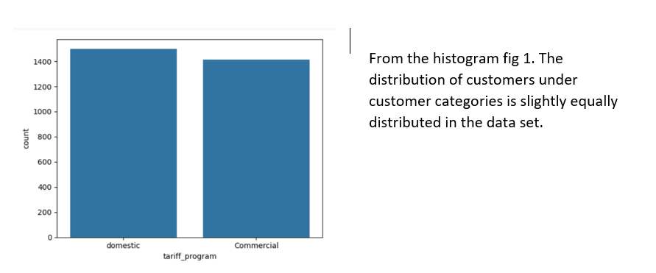
Methodology Approach cont

Slide 11
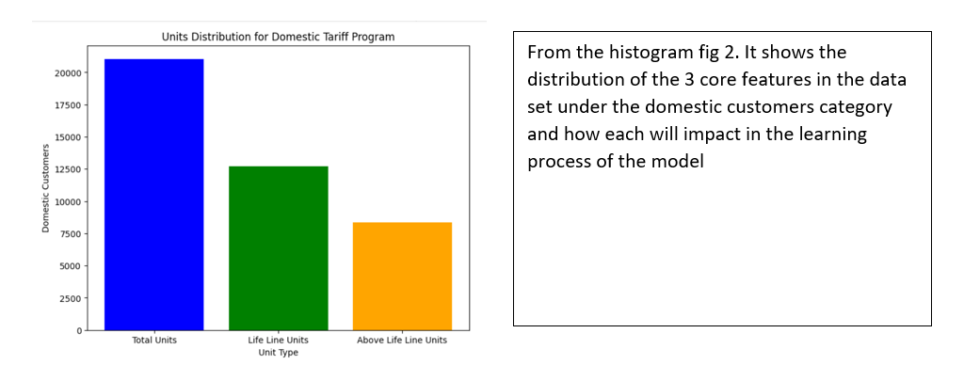
Methodology Approach cont

Slide 12
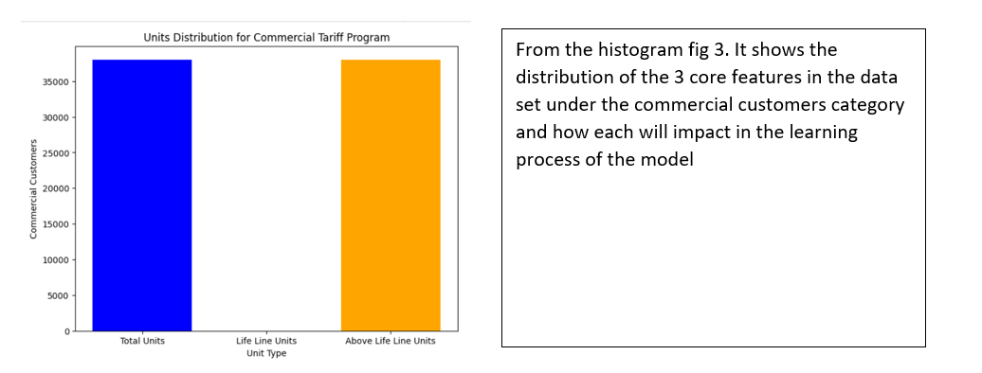
Methodology Approach cont

Slide 13
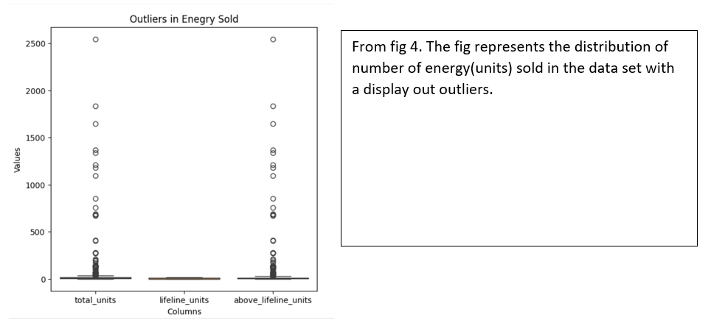
Methodology Approach cont

Slide 14
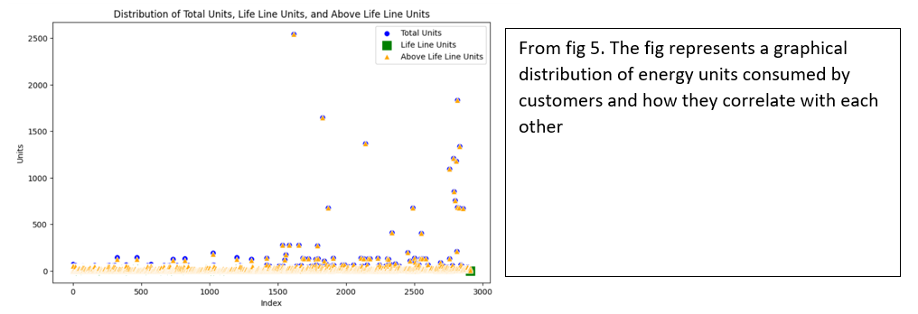
Methodology Approach cont

Slide 15
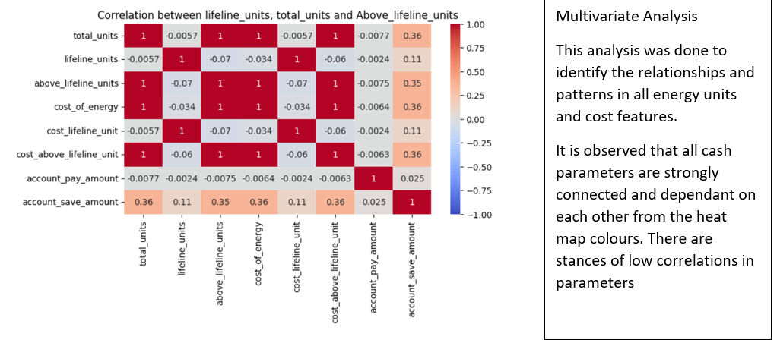
Methodology Approach cont

Slide 16
Module Training
Four models below were trained with the Train-Test split method of (40% test and 60% train)
K-Nearest Neighbour
Logistic Regression
Decision Trees
Random Forests

Slide 17
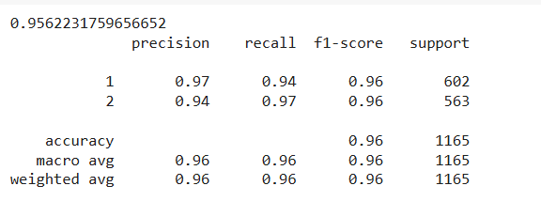
Module Training
K-Nearest Neighbour
The model was trained with 3 different values of K, and they returned accuracy results below
For K=1

Slide 18
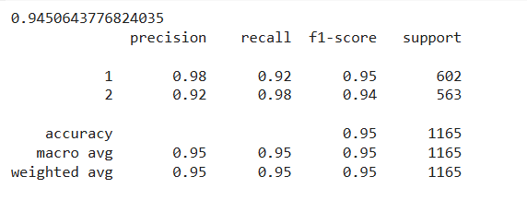
Module Training
K-Nearest Neighbour
For K=3

Slide 19
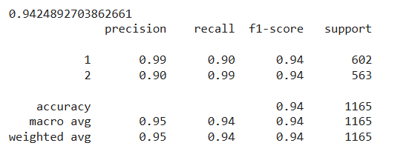
Module Training
K-Nearest Neighbour
For K=5

Slide 20
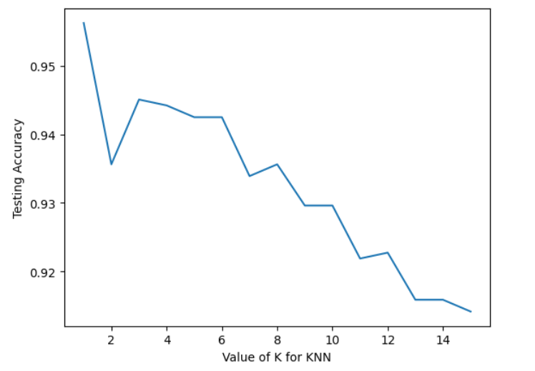
Module Training
K-Nearest Neighbour
For a range of k running from 1-15 visualized in a line graph

Slide 21
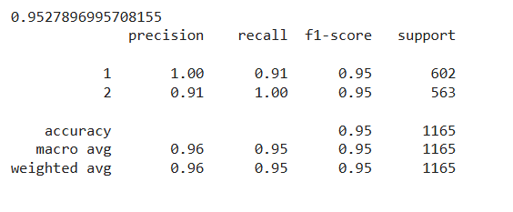
Module Training
Logistic Regression

Slide 22
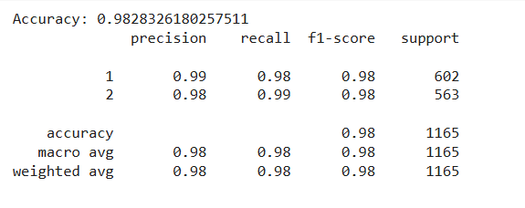
Module Training
Decision Trees

Slide 23
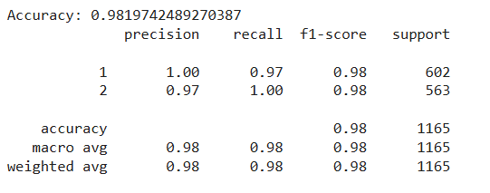
Module Training
Random Forests

Slide 24
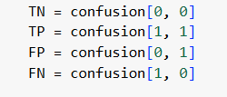

Module Evaluation
Confusion Matrix
Matrix dimension
0- Domestic Category
1- Commercial Category

Slide 25




Module Evaluation
Confusion Matrix Metrics
1. Classification Accuracy
2. Classification Error
3. Recall
4. Precision

Slide 26
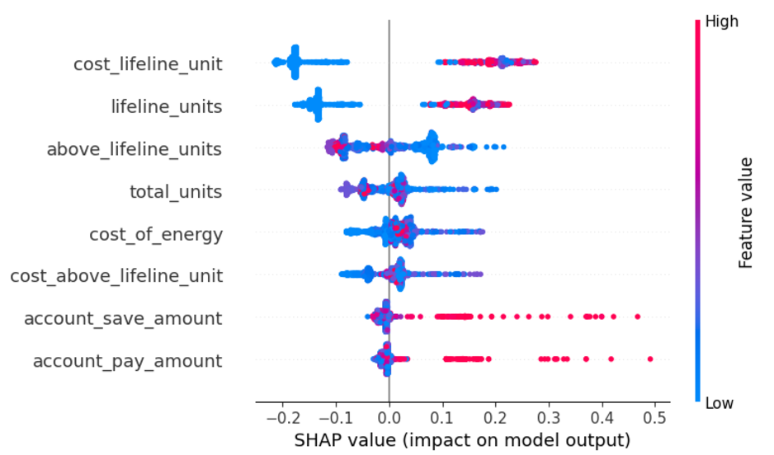
SHAP function
Fig 1

Slide 27
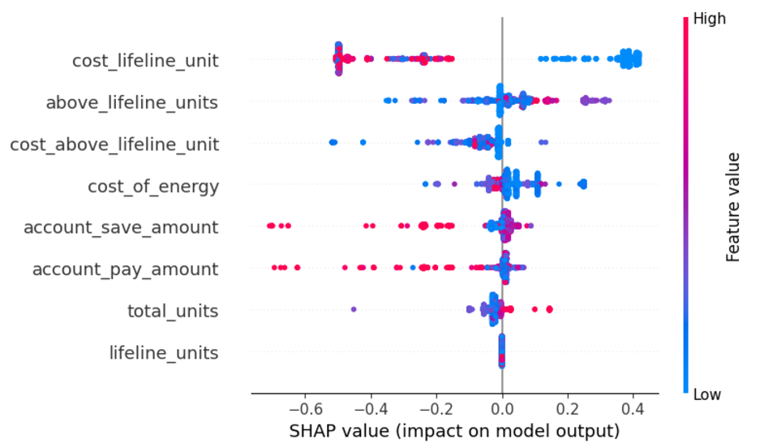
SHAP function
Fig 2

Slide 28
SHAP function
The x-axis represents the SHAP interaction values, indicating the effect of feature interactions on the prediction.
The further a point is from zero, the stronger its impact on the model’s prediction.
Positive values indicate a positive contribution to the prediction, while negative values indicate a negative contribution.
The cell where "total_units" intersects with itself (top-left) shows the effect of "total_units" alone on the prediction.
The cell where "total_units" intersects with "lifeline_units" shows the interaction effect between these two features.

Slide 29
SHAP function cont
The cell where "total_units" intersects with "lifeline_units" shows how these two features influence each other in predicting the outcome. If there’s a clear trend or separation between colors, the interaction between these two features has a meaningful impact on the model’s predictions.
This plot suggests that both "total_units" and "lifeline_units" interact with each other and with themselves to influence the model's predictions.

Slide 30
Conclusion and Future Work
Preferably, the team would continue with the Decision tree model because it provides the best classification accuracy with no overfitting occurrences in both precision and recall
This project highlights areas for improvement in billing processes. Future work could involve automating anomaly detection and improving real-time adjustments to minimize delays and errors in billing apart from only classifying customer categories

